Slide 1
Constructing Equity Portfolio
Team Members Group No: 61 Panel Number:2
S.No | Reg.No | Name of the Student | Section
1 | CB.EN.U4CSE18125 | Karthik Desai | CSE B
2 | CB.EN.U4CSE18160 | V.S.V.Akanksh | CSE B
3 | CB.EN.U4CSE18235 | Kushagra Kumar Agrawal | CSE C
4 | CB.EN.U4CSE18244 | Reddybathuni Mohan | CSE C
Project Advisors:
Dr. (Col.) Kumar P. N. / Professor / CSE
Dr. A. Senthil Kumar /Assistant Professor (SG)-Finance /ASB

Slide 2
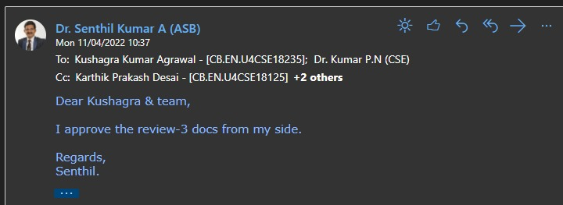
Guide Approval Mail

Slide 3
Problem Definition
Constructing equity portfolios using the prominent optimization algorithms

Slide 4
Review 2 comments and responses
Individual contribution has to be defined clearly.
Distribution of the work.

Slide 5
Literature Survey
Hanhong Zhu, Yi Wang, Kesheng Wang, Yun Chen, “Particle Swarm Optimization (PSO) for the constrained portfolio optimization problem”, Expert Systems with Applications, Volume 38, Issue 8, 2011
a. Inference:
A direct approach of PSO on the stock assets with various number of stocks in portfolio. Sharpe ratio and efficient frontier are used in restricted and unrestricted(short selling allowed).
b. Research gap:
Hybrid version of PSO can be applied for the same problem.
Kambiz Forqandoost Haqiqi and Tohid Kazemi,”Ant Colony Optimization Approach to Portfolio Optimization – A Lingo Companion”.International Journal of Trade, Economics and Finance, Vol. 3, No. 2, April 2012.
a. Inference:
To chose the good solution path which has been taken the most. The good quality solution probability remains high, if that path is taken often and other path probability diminishes.
b. Research Gap:
More attempts are to be made to improve ACO algorithm towards a more applicable one.

Slide 6
Literature Survey
3. Boris Georgiev.”Constrained Mean-Variance Portfolio Optimization with Alternative Return
Estimation”. International Atlantic Economic Society 2014.
Inference:
i. In portfolio analysis one of the main problems is to obtain sound predictions of expected
future returns and covariance among the assets.
ii. An alternative model for the estimation of expected returns is proposed.
iii. Both suggested portfolios (Maximized Sharpe and information ratio) yield positive results
and provide evidence for superior returns, compared to other alternative investment
options such as holding a market index or investing in a risk-free asset.
Research gap:
i. The final choice between the two strategies depends on the risk preferences of the investor.

Slide 7
Literature Survey
4. Saina Abolmaali,”Portfolio Optimization using ant colony method a case study on Tehran stock exchange”,Journal of Accounting, Finance and Economics,Vol. 8. No. 1. March 2018 Issue. Pp. 96 – 108
Inference:
a. It has used Meta heuristic methods which is active area of research.
b. The traditional method couldn’t fulfill the constraints of investor, which is solved here.
Research gap :
a. It can be expanded in different constraints and fitness ratio used in portfolio optimization.
5. Dorigo, M, Birattari, M, Blum, C, Gambardella, LM, Mondada, F and Stutzle, T 2004,‘Ant Colony Optimization and Swarm Intelligence: 4th International Workshop’, ANTS 2004. Proceedings, Lecture Notes in Computer Science, 3172
Inference:
The bias improvement in algorithm was detected and solution was found.

Slide 8
Literature Survey
6. Marco Dorigo, Mauro Birattari, and Thomas Stu¨tzle,”Ant Colony Optimization Artificial Ants as a Computational Intelligence Technique”,.IEEE,November 2006.
a. Inference:
The concept of ACO was explained.
b. Research gap:
To be explored and implemented in various domain.
7. Harry Markowitz,Portfolio Selection, The Journal of Finance,Vol. 7,1952.
Inference:
The original paper by Markowitz on his idea of portfolio selection. It has become the most used approach for portfolio construction.

Slide 9
Literature Survey
8. Arushi Gupta,Smriti Srivastava,“Comparative Analysis of Ant Colony and Particle Swarm
Optimization Algorithms for Distance Optimization”,(ICITETM 2020)
a. Inference:
Objective is to solve two distance optimization using two separate swarm intelligence
algorithms-particle swarm and ant colony. Both the algorithms analysis is compared.Any
optimization algorithm is said to be effective if it converges to global minima in less number
of iterations.Objective is to find shortest path or distance between two vertices. Comparative
analysis is done using PSO and ACO. ACO is a probability based method on the behaviour
of ants to find the shortest path set by other ants.
b. Research Gap :
Application of ACO and PSO in stock market optimization.
c. Conclusion:
Results for both ACO and PSO were both demonstrated.It is observed that the ACO
algorithm has a lower square of error (0.2 at 80 iterations) and an overall better
performance.

Slide 10
Literature Survey
9. Chen, R.-R., Huang, W. K., & Yeh, S.-K. (2021). Particle swarm optimization approach to portfolio construction. Intelligent Systems in Accounting, Finance and Management, 1–13.
Inference:
The approach was applied on USA market. Sortino ratio was preferred.
results were compared and analysed w.r.t. other algorithms and computation time.
10. Burcu Adıgüzel Mercangöz and Altaf Q. H. Badar,”Optimal Portfolio Selection with Particle Swarm Algorithm: An Application on BIST-30”,Springer Nature Switzerland AG 2021.
Inference:
PSO was compared GRG for the construction of the portfolios.
Weights were compared and analysed. THe results were similar and inferred PSO is good approach to in this domain.

Slide 11
Literature Survey
11. Dadabada Pradeep Kumar,”Particle Swarm Optimization: The Foundation”Applying Particle Swarm Optimization, International Series in Operations Research & Management Science 306.
Inference:
It was a Summarized or combined comparison of various PSO papers. It tablised the PSO parameters, various domain it is applied.
12. Senthilkumar, A., Namboothiri, A., & Rajeev, S. (2021). Does portfolio optimization favor sector
or broad market investments? Journal of Public Affairs, e02752.
a. Inference:
Optimizing the portfolio there are variety of combinations, a portfolio can be of intra-sector
assets or inter sector portfolio, in intra-sector portfolio and inter-sector portfolio are compared.
A comparison is made with between the Markowitz model and Sharpe’s model.
b. Research gap:
Explore how weights change under different economic conditions .Use of advance Machine
learning algorithm.To expand it in global context

Slide 12
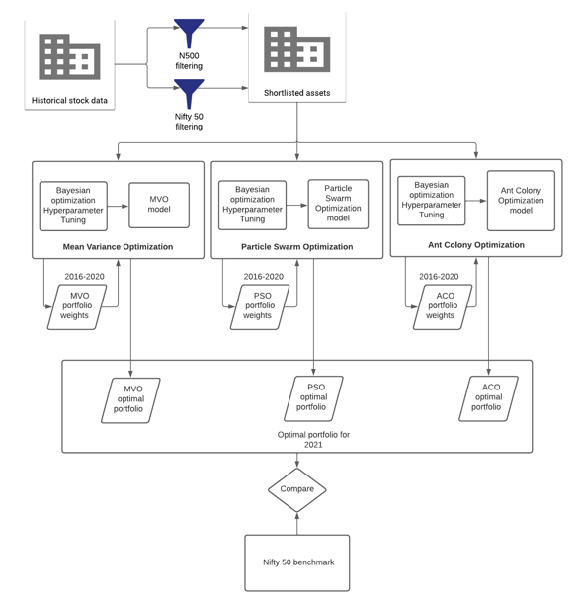
Architecture diagram

Slide 13
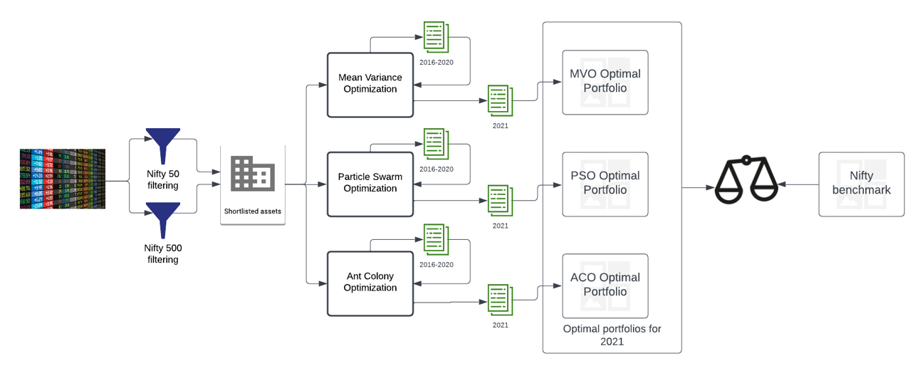
Detailed design diagram

Slide 14

List all the Modules
Sharpe and Sortino Filtering
Mean- Variance Optimization
Particle Swarm Optimization
Ant Colony Optimization
Implementing using static data (2016-2021)
Nifty50 Index Benchmark risks and returns
LSTM(future enhancement)

Slide 15
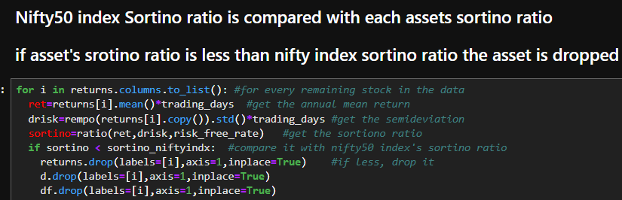
Implementation
Filtering Data
Nifty Filtering:
Data is filtered using the below 2 criteria.
Data is available for throughout the time period.
Sortino ratio of stock must be greater than Sortino Ratio of the Nifty index.(because stock with downside volatility are considered if greater than whole nifty index sortino ratio.

Slide 16
Implementation
Mean Variance Optimization
This is a Conventional way that is being followed for constructing the portfolio.
Here randomly weights are assigned to each stock in each iteration. It tries to to find all the portfolios by trying almost all possible weight combination in the iteration limit defined.
Variables are initialized and assigned which are required for MVO. Such as
For each stock daily return data frame is created
Trading days is calculated
Annualized covariance matrix for sharpe and sortino ratios are made
Weights for each stock is allocated which sum up to 1
Returns and risk are calculated
The MVO is run for many iterations(50000) for each iteration the sharpe ratio and sortino ratio portfolio are stored as dataframe.

Slide 17
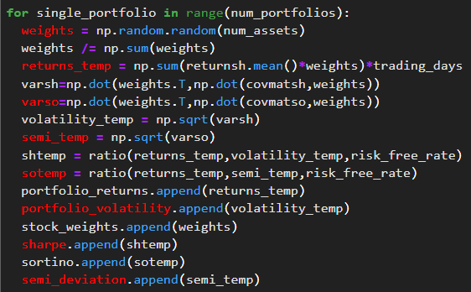
Implementation
Mean Variance Optimization

Slide 18
Implementation
Particle Swarm Optimization
Each bird searches for the food in its own direction. The near by bird follows the bird which gets more food and this way all the birds tend to travel in that direction hence finding the maximum food. (food is metaphor to max returns and min risk here)
Variables are initialized and assigned which are required for PSO. Such as
For each stock daily return dataframe is created
Trading days is calculated
Annualized covariance matrix for sharpe and sortino ratios are made
Weights for each stock is allocated which sum up to 1
Returns and risk are calculated
PSO Model is tuned using Bayesian optimization (for parameters as Swarm size,iterations)
There is fitness function check and particles’ velocity and position update formula for finding the optimum solution over each iterations

Slide 19
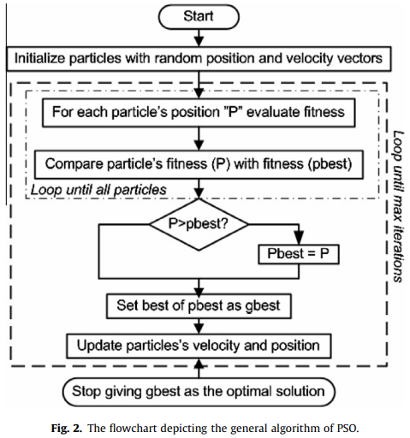
Implementation
Particle Swarm Optimization

Slide 20
Implementation
Ant Colony Optimization
Ants deposit pheromone as they walk and find their route by walking along the pheromone deposition. Density of pheromone increases as they walk back to source with food. Pheromone deposition is proportional to the number of ants.
Returns for sortino for positive returns are nulled as sortino measures the assets changes from a downfall deviation. Sharpe takes both positive and negative returns.
Covariance of annualised returns are calculated for evaluating standard deviation.
Random probability are initialised and based off these values , the ants determine the next pheromone update by updation formula. To avoid initial pheromone preferability, an evaporation update is done to make sure the ants search for the best fitness values globally.
The global weights are the final component for the parts of investment and fitness values determine the accuracy of each weighted combination of assets.
We have performed Bayesian optimization for the hyperparameter tuning in ACO since they maximise the loss function and returns globally highest parameters. Framework for Bayesian hyperparameter optimization- Optuna

Slide 21
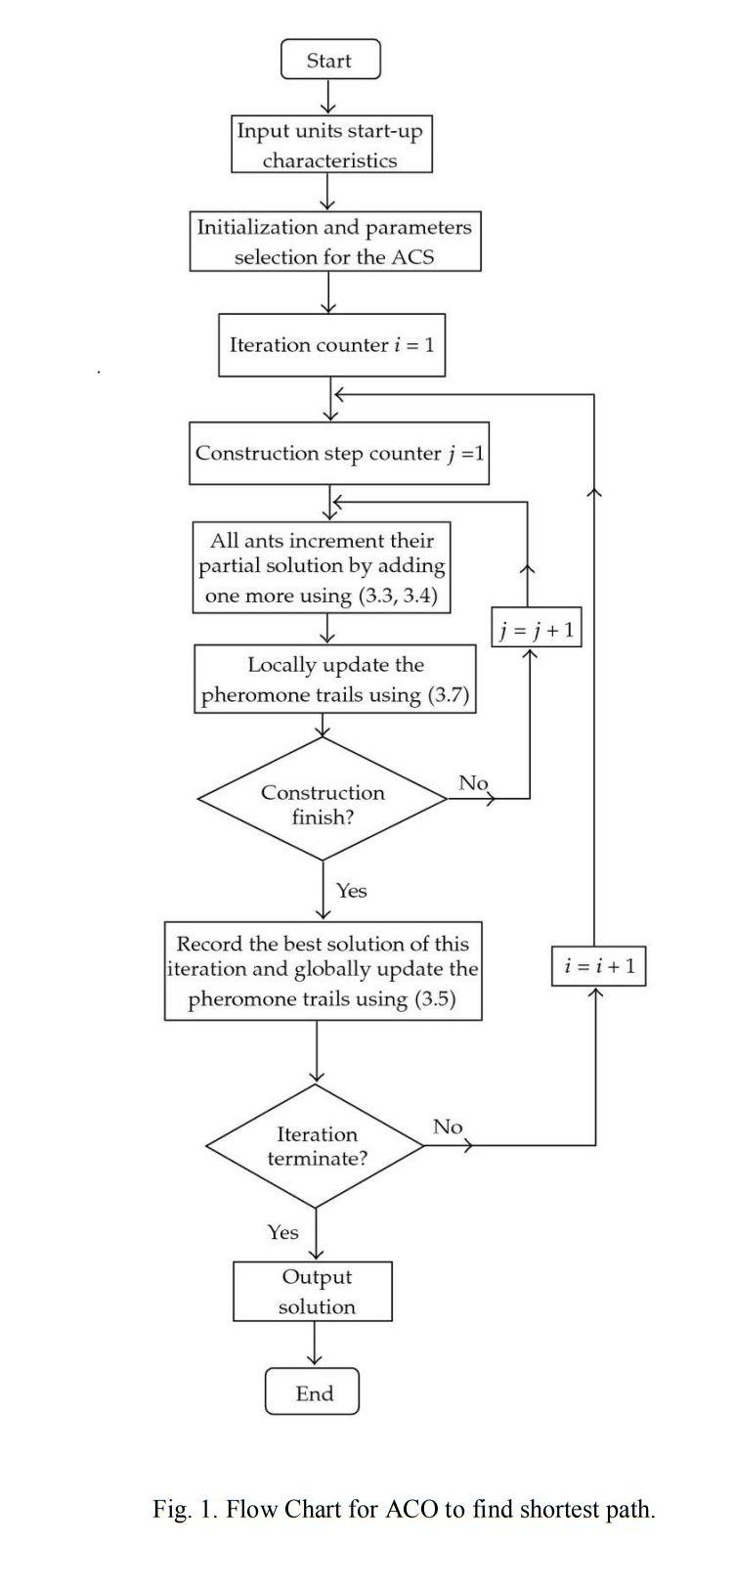
Implementation
Ant Colony Optimization

Slide 22
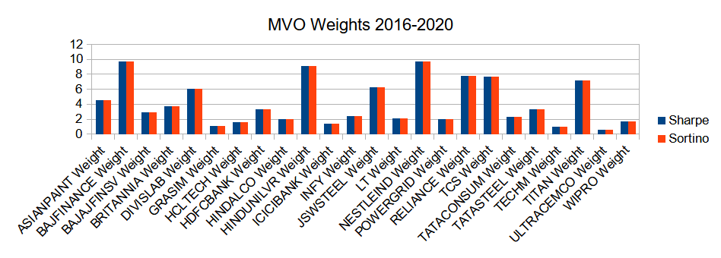
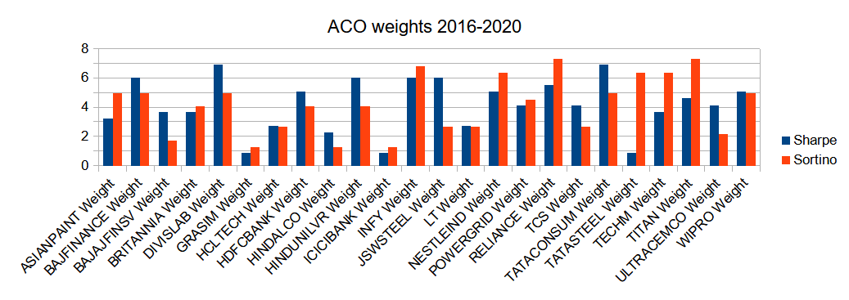
Results and Inferences

Slide 23
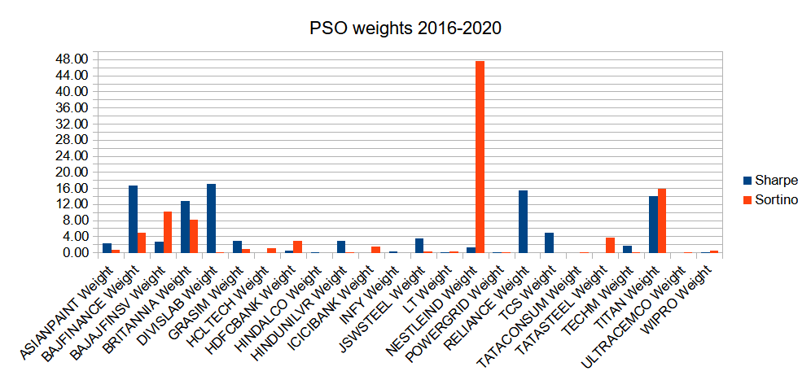
Results and Inferences

Slide 24
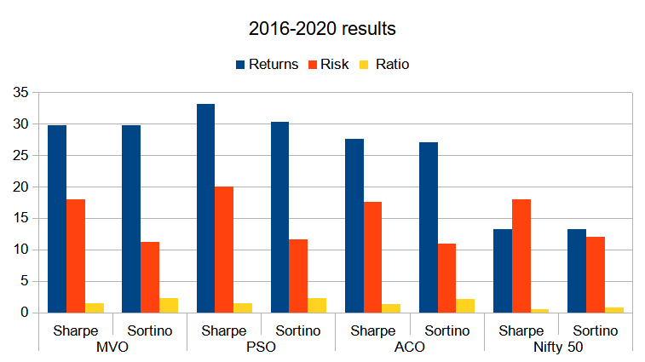
Results and Inferences

Slide 25
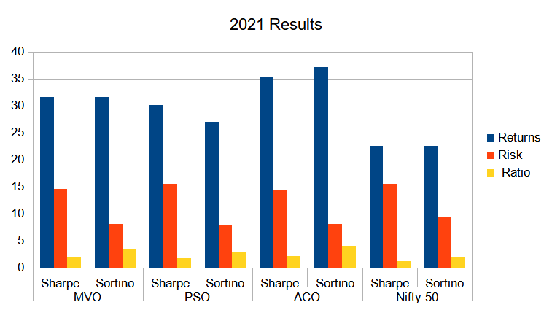
Results and Inferences

Slide 26
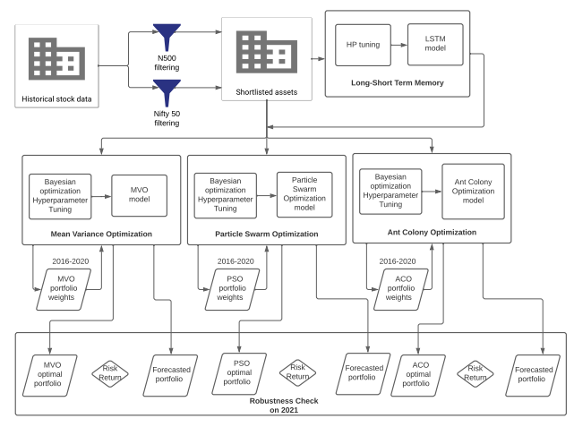
Future Enhancements
Future predicted portfolios can be constructed using accurate time series algorithm(LSTM,ARIMA,etc.).

Slide 27
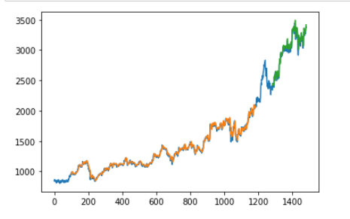
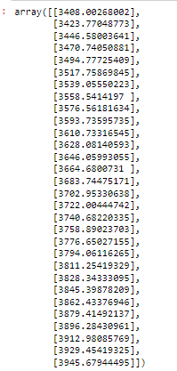
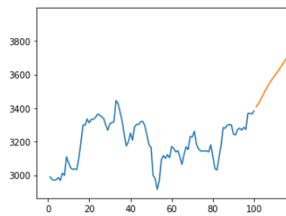
Future Enhancements

Slide 28
Conclusion
The Results above throws the light on, how a simple filtering method can help us select appropriate stocks out of Nifty50 and improve the investment returns.
The optimal weights from each optimization algorithm on the training data(2016-2020), perform well in 2021 year. The graphical representation compares the same with the benchmark(nifty50).
The Results show and provide sufficient evidence to do in depth research in the topic. It will be beneficial to perform dynamic approach, sliding the dataset day by day to get relevant results in real time.
Statistical techniques can be performed on day wise results for getting strong evidence of the project.
The project can be scaled up to Nifty500 or Nifty250, depending on computation power available.

Slide 29
References(In IEEE format)
[1] Hanhong Zhu, Yi Wang, Kesheng Wang, Yun Chen, Particle Swarm Optimization (PSO) for the constrained portfolio optimization problem, Expert Systems with Applications, Volume 38, Issue 8, 2011,
[2] Kambiz Forqandoost Haqiqi and Tohid Kazemi,”Ant Colony Optimization Approach to Portfolio Optimization – A Lingo Companion”.International Journal of Trade, Economics and Finance, Vol. 3, No. 2, April 2012
[3] Boris Georgiev.”Constrained Mean-Variance Portfolio Optimization with Alternative Return Estimation”. International Atlantic Economic Society 2014.
[4] Saina Abolmaali,”Portfolio Optimization using ant colony method a case study on Tehran stock exchange”,Journal of Accounting, Finance and Economics,Vol. 8. No. 1. March 2018 Issue. Pp. 96 – 108
[5] Dorigo, M, Birattari, M, Blum, C, Gambardella, LM, Mondada, F and Stutzle, T 2004,‘Ant Colony Optimization and Swarm Intelligence: 4th International Workshop’, ANTS 2004. Proceedings, Lecture Notes in Computer Science, 3172

Slide 30
References(In IEEE format)
[6] Marco Dorigo, Mauro Birattari, and Thomas Stu¨tzle,”Ant Colony Optimization Artificial Ants as a Computational Intelligence Technique”,.IEEE,November 2006.
[7] Harry Markowitz,Portfolio Selection, The Journal of Finance,Vol. 7,1952.
[8] Arushi Gupta,Smriti Srivastava,“Comparative Analysis of Ant Colony and Particle Swarm Optimization Algorithms for Distance Optimization”,(ICITETM 2020)
[9] Chen, R.-R., Huang, W. K., & Yeh, S.-K. (2021). Particle swarm optimization approach to portfolio construction. Intelligent Systems in Accounting, Finance and Management, 1–13.
[10] Burcu Adıgüzel Mercangöz and Altaf Q. H. Badar,”Optimal Portfolio Selection with Particle Swarm Algorithm: An Application on BIST-30”,Springer Nature Switzerland AG 2021.

Slide 31
References(In IEEE format)
[11] Dadabada Pradeep Kumar,”Particle Swarm Optimization: The Foundation”Applying Particle Swarm Optimization, International Series in Operations Research & Management Science 306.
[12] Senthilkumar, A., Namboothiri, A., & Rajeev, S. (2021). Does portfolio optimization favor sector or broad market investments? Journal of Public Affairs, e02752.

Slide 32
THANK YOU

